Slide 1

Opening Night Dinner
April 1st 2025

Slide 2
2025 Opening Dinner Agenda
Welcome & Opening Remarks
Jack McFarland, Head Coach
Vince Kelly, President Diamond Club
Coaches’ Overview
Freshman - Don Smith, Head Coach
Junior Varsity -Scott Carew, Head Coach
Varsity - Jack McFarland, Head Coach
Diamond Club Overview
Vince Kelly & Eric Oppenheimer
Guest Speaker
David Speer
Evening Wrap Up by Varsity Captains
Go Wreckers!!!

Slide 3
Welcome & Opening Remarks

Slide 4
Coaches Overview

Slide 5
Freshman Team
Head Coach
Donnie Smith
Assistant Coach
Ron Clarke
Ryan Trani

Slide 6
Junior Varsity Team
Head Coach
Scott Carew
Assistant Coach
Mike Caetano
Mike Cusa

Slide 7
Varsity Team
Head Coach
Jack McFarland
Assoc. Head Coach
Brian Sikorski
Assistant Coaches
Bob Buswell
Keith Avery

Slide 8
Diamond Club Overview

Slide 9

The Diamond Club Supports the Staples Baseball Program
Acknowledgements
Founded in 2005
Volunteer 501(c)3 non-profit
Consists of players’ parents and Staples baseball supporters working together to ensure our student athletes have a positive experience
Welcome Letter & Diamond Club Membership Dues

Slide 10
Board Members
2025
Doug Bernstein
Paloma Bima
Aileen Brill
Jeffrey Brill
Steven Greenberg
Vince Kelly
Antonia Landgraf
Jack McFarland
Brian Marcucio
Michelle Murphy
Colleen Oppenheimer
Eric Oppenheimer
Brian Sikorski
Robert Smoler
Mike Vizzo

Slide 11
Events & Fundraisers
KEY DATES:
April 5th – Opening Game Day
April 18th – Team Pasta Dinner @ Cafeteria
April 30th – Little League Day
May 13th – Team Pasta Dinner @ Cafeteria
May 14th – Senior Day
May 20th – Team Pasta Dinner @ Cafeteria
May 21st – Breast Cancer Survivors Day
May 25th – Challenger Day
May 23rd – 29th - FCIAC PLAYOFFS
May 31st – Closing Dinner
June 2nd – June 14th – STATE PLAYOFFS

Slide 12
Team Support
Varsity Captains’ Parents
Michelle Murphy, Virginia Nee, Colleen Oppenheimer, Lauren Goldshore
Team Parents
JV: Need a Volunteer!
FR: Need a Volunteer!
Communicate updates from Coaches & Diamond Club
Organize “Game Night” Dinners
Organize Away Game Bus Snacks
Confirm Parent Photographer for Each Game >>> send to sbcsocialct@gmail.com

Slide 13
Stay Informed
More information about Staples Baseball can be found on the Staples Baseball Website staplesbaseball.com, including
News & Updates
Box Scores
Livestream Links
Photographs from most games
Follow us on social media:
Team Instagram: @staples.baseball
Team Facebook Page: StaplesBaseball
Schedules: Download to your calendar from ciacsports.com
Staples Diamond Club email: baseball@staplesdiamondclub.com

Slide 14

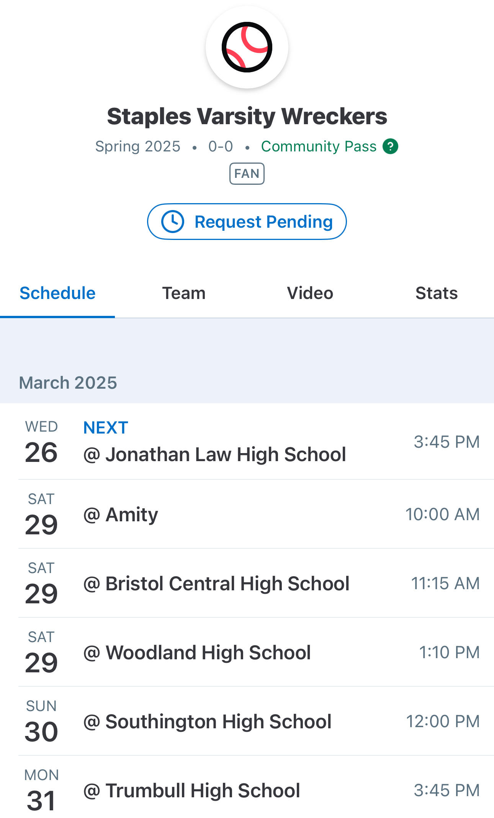
GameChanger
We purchased the Premium Community Package
All 3 teams schedules will be up on GC
Updates, messages and all information shared via GC
Games broadcasted via GC video

Slide 15
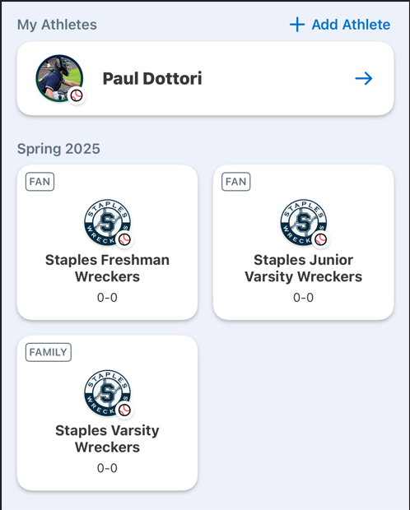
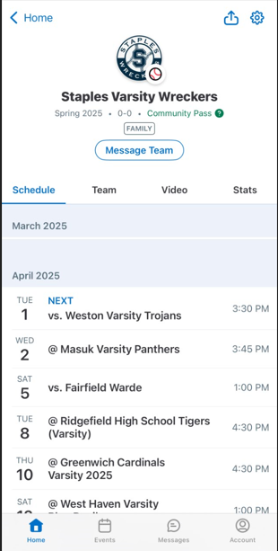
GameChanger
Register on GC App, ensure email and cellphone is updated.
Add your Son’s profile
Search for teams. You can become a Family Member (will be verified) or a Fan.
All schedules are updated.
View videos and games live via webstream
Messages with updates will be send using email/cell on the app.

Slide 16
We are Grateful to our 2025 Season Sponsors
Please Support them whenever possible
Anderson Septic Service
ASF Sports & Outdoors
Basso Plumbing Heating & Cooling
Big Y
Colony Grill
Connecticut Children's
Curran VW
Dean Cleaners
Garden Catering
Green Acres Landscaping
Kona HR
Malone's Refuse Service
Nomade
Nutmeg Sporting Goods
Riko's Pizza
Stiles Market
Teed & Brown
The Blondinit
The Clubhouse Westport
The Toy Post
Wagmore
Walrus Alley
Howard & Gay Insurance
ICON Auto
IST

Slide 17
Guest Speaker
David Speer

Slide 18
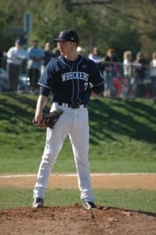
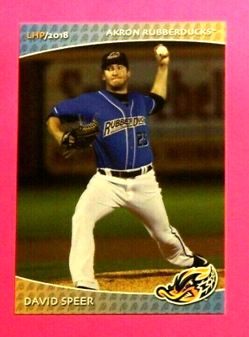
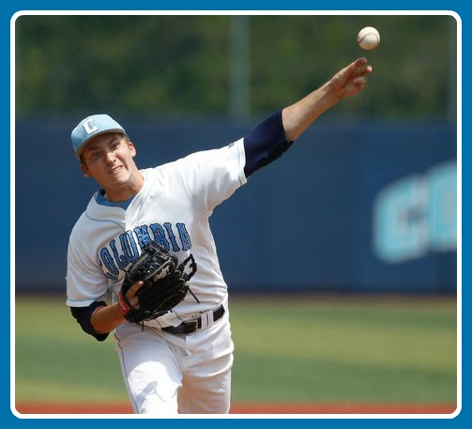
David Speer
Stapes HS Class of 2010
FCIAC Champions 2008 & 2009
1st Team All FCIAC 2008, 2009, 2010
1st Team All State 2009, 2010
All Time Winningest Pitcher Staples – 22 wins
Columbia University Class of 2014
Ivy League Champions 2013, 2014
1st Team All Ivy League 2013, 2014
Unanimous Ivy League Pitcher of the Year 2014
Drafted in the 27th Round of the 2014 Draft by the Cleveland Guardians
Pro Career: 24-16; 2.93 ERA, 13 Saves and 320Ks in 356 Career Innings.

Slide 19

2025 Captains

Slide 20
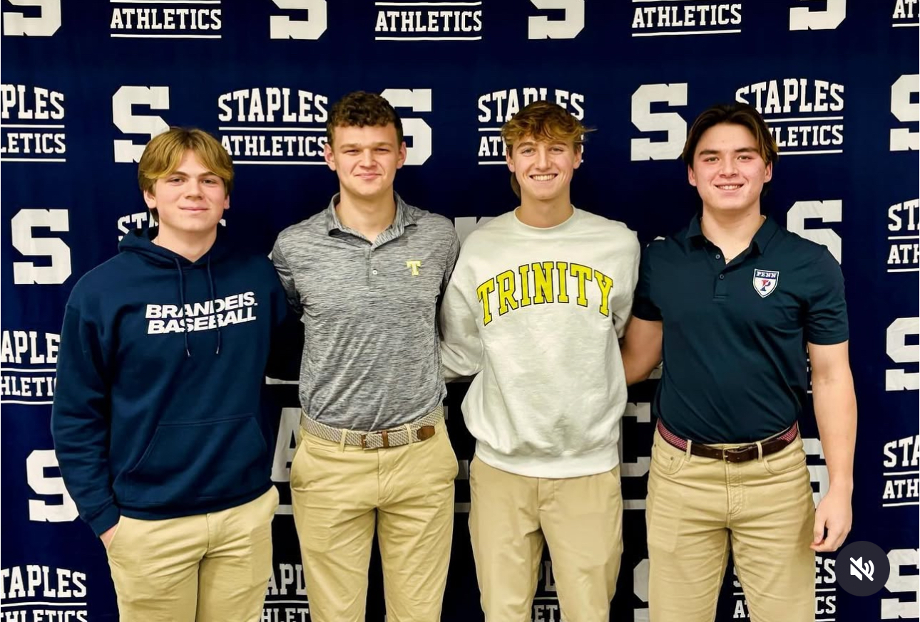
Message from our Varsity Captains

Slide 21

Thank You for Attending
We look forward to a Fantastic Season
GO WRECKERS!!

